Slide 1
Puppet Agent Configuration on Windows – Troubleshooting Connection to Puppet Master
┌────────────────────────┐ ┌────────────────────────┐
│ Puppet Master (Linux) │ <──→── Puppet Agent (Windows) |
└────────────────────────┘ └────────────────────────┘
Port 8140 open Communicates via SSL

Slide 2
Install Puppet Agent on Windows
Step 1: Download the Installer
Download the Puppet Agent for Windows from the official site:
https://downloads.puppet.com/windows/puppet-agent-x64-latest.msi

Slide 3
Step 2: Install Puppet Agent
Run the .msi installer.
During installation, choose default options.
Once installed, open Command Prompt (Admin) and verify:
puppet --version

Slide 4
Important Puppet Paths
Item | Path
Puppet conf | C:\ProgramData\PuppetLabs\puppet\etc\puppet.conf
SSL certs | C:\ProgramData\PuppetLabs\puppet\ssl\
Executables | C:\Program Files\Puppet Labs\Puppet\bin\

Slide 5
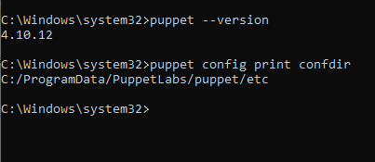
Check Puppet Config Path Dynamically
Run this to get where Puppet expects the config directory:
puppet config print confdir

Slide 6
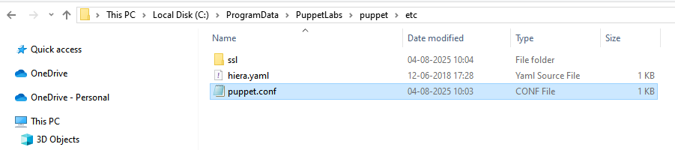
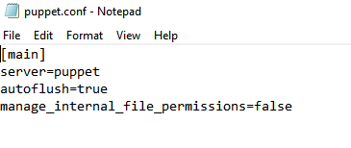

Slide 7
Directive | Description | Real-World Analogy
server=puppet | Specifies the hostname of the Puppet master server (e.g., puppet, puppet.example.com). The agent will communicate with this master. | 📞 “Call this number (server) for work instructions.”
autoflush=true | Forces Puppet to immediately flush logs and reports to disk instead of buffering them. Useful for real-time troubleshooting. | 💧 “Don't store logs in memory—write them instantly.”
manage_internal_file_permissions=false | Prevents Puppet from enforcing file permissions on internal files (like SSL certs). Useful on Windows to avoid file access issues. | 🔒 “Don’t change security settings—we’ll handle it ourselves.”

Slide 8
Real-World Analogy
server=puppet: “This is the boss’s phone number I call for work.”
autoflush=true: “I write down what I’m doing instantly — no waiting.”
manage_internal_file_permissions=false: “I don’t touch file locks — the OS handles it.”

Slide 9


Slide 10
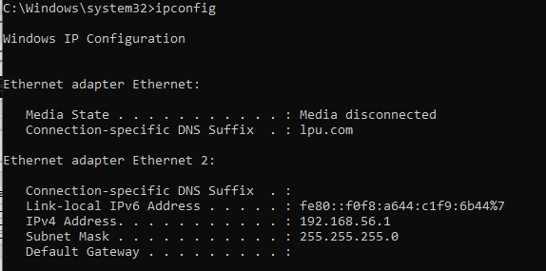

Slide 11
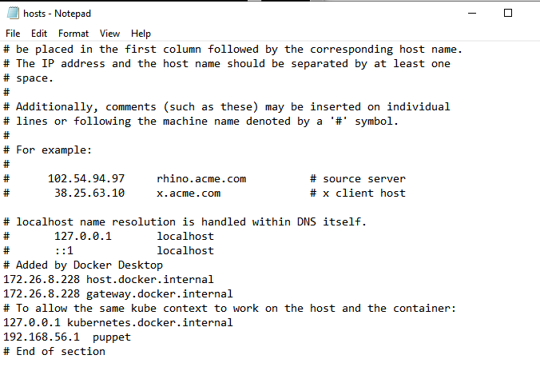

Slide 12
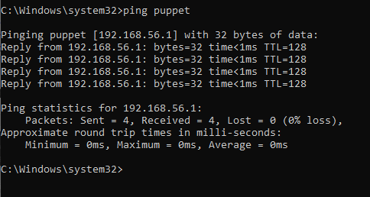

Slide 13
Important Note
Puppet Server (Master) is not supported natively on Windows as a master — it's officially designed to run on Linux systems only (e.g., Ubuntu, CentOS, RHEL).
Windows is supported only for Puppet Agent — not the Master.
So that's likely why nothing is listening on port 8140 — the Puppet Server isn't installed or isn't capable of running on Windows.

Slide 14
 | Installing Puppet Agent on Windows
 | Configuring puppet.conf and hosts File
 | Opening Firewall Port 8140 for Puppet Communication
 | Troubleshooting: Puppet Agent Cannot Connect to Master
 | Why Puppet Master Doesn’t Work on Windows
 | Recommended Setup: Puppet Master on Linux + Windows Agent

Slide 15
Ubuntu ISO Image for VM
https://ubuntu.com/download/server

Slide 16
Step 1 – Prepare your Ubuntu VM
Update package index
sudo apt update && sudo apt upgrade -y
Install curl, wget, and other helpers
sudo apt install curl wget lsb-release -y

Slide 17
Step 2 – Set a static IP
sudo nano /etc/netplan/00-installer-config.yaml
Nano file
network:
ethernets:
enp0s3:
dhcp4: no
addresses:
- 192.168.1.50/24
gateway4: 192.168.1.1
nameservers:
addresses: [8.8.8.8, 1.1.1.1]
version: 2

Slide 18
Execute: sudo netplan apply
If its not working then run
sudo chown root:root /etc/netplan/00-installer-config.yaml
sudo chmod 600 /etc/netplan/00-installer-config.yaml
sudo netplan apply

Slide 19
Verify
ip a
ping google.com

Slide 20
Step 3 – Install Puppet Server on Ubuntu 24.04.2
wget https://apt.puppet.com/puppet8-release-jammy.deb : for puppet repository
sudo dpkg -i puppet8-release-jammy.deb : for repo packages
sudo apt update: For update packages
sudo apt install puppetserver –y : For Installing puppet server

Slide 21
Step 4 – Configure Puppet Server
sudo nano /etc/default/puppetserver
Add in nano file
JAVA_ARGS="-Xms1g -Xmx1g"

Slide 22
Step 5 – Enable & Start Puppet Server
sudo systemctl enable puppetserver
sudo systemctl start puppetserver optional
sudo systemctl status puppetserver

Slide 23
Step 6 – Configure puppet.conf
Run this command and make conf file
sudo nano /etc/puppetlabs/puppet/puppet.conf
[main]
certname = puppet master.local
server = puppet-master.local
environment = production
runinterval = 1h

Slide 24
Step 7 – Set Hostname & Hosts File
sudo hostnamectl set-hostname puppet-master.local
Edit /etc/hosts File
sudo nano /etc/hosts
192.168.1.50 puppet-master.local puppet

Slide 25
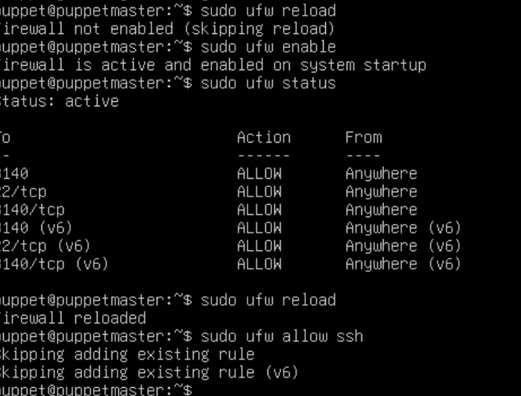
Step 8 – Allow Puppet Ports in Firewall
sudo ufw allow 8140
sudo ufw reload
Or
sudo ufw enable
sudo ufw status
sudo ufw reload
Sudo ufw allow ssh

Slide 26
Step-9 Test Puppet Server
sudo /opt/puppetlabs/bin/puppetserver ca list
If facing error then follow next steps

Slide 27
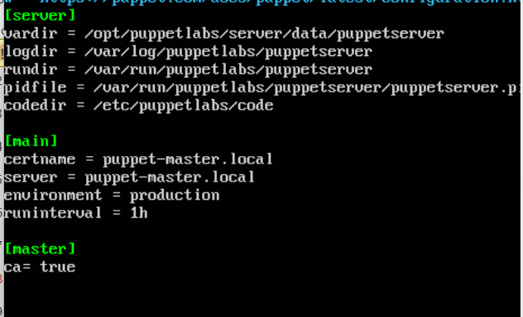
2. Configure Puppet Server
Edit puppet.conf:
sudo nano /etc/puppetlabs/puppet/puppet.conf

Slide 28
3. Set hostname and hosts file
sudo hostnamectl set-hostname puppetmaster.local
Edit hosts file:
sudo nano /etc/hosts
Add:
192.168.56.10 puppetmaster.local puppetmaster 192.168.56.1 windows-agent.local windows-agent

Slide 29
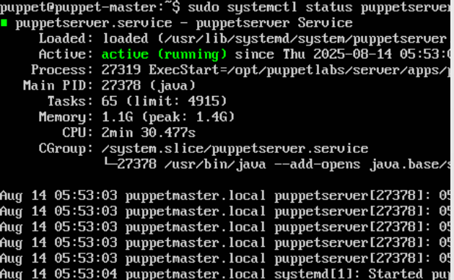
4. Start Puppet Server
sudo systemctl enable puppetserver
sudo systemctl start puppetserver
sudo systemctl status puppetserver

Slide 30
Already done Skip these steps
On the Windows Puppet Agent (192.168.56.1)
1. Install Puppet Agent
Download from Puppet official site:
https://downloads.puppet.com/windows/puppet7/puppet-agent-x64-latest.msi
Install with default options.

Slide 31
2. Configure Agent
Open PowerShell as Administrator:
Notepad"C:\ProgramData\PuppetLabs\puppet\etc\puppet.conf“
Add:
[main]
server = puppetmaster.local
certname = windows-agent.local
environment = production

Slide 32
3. Update Windows hosts file
Edit:
notepad C:\Windows\System32\drivers\etc\hosts
Add:
192.168.56.10 puppetmaster.local puppetmaster 192.168.56.1 windows-agent.local windows-agent

Slide 33
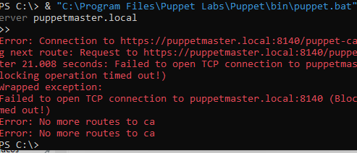
3. Connecting Master and Agent
1. From Windows Agent — request certificate
& "C:\Program Files\Puppet Labs\Puppet\bin\puppet.bat" agent --test --server puppetmaster.local
This will show something like:
Notice: Did not receive certificate
That’s fine — now sign it on the master.

Slide 34
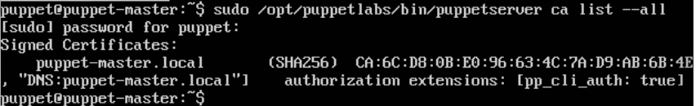
2. From Puppet Master — sign certificate
Check pending certs:
sudo /opt/puppetlabs/bin/puppetserver ca list

Slide 35
Steps to Connect Windows Puppet Agent with Ubuntu Puppet Master
1. On Ubuntu Puppet Master: Master in active state
sudo systemctl status puppetserver
If not running, start it:
sudo systemctl start puppetserver
sudo systemctl enable puppetserver
Allow Puppet port 8140 in the firewall:
sudo ufw allow 8140/tcp
sudo ufw reload
If firewall not allow
sudo ufw enable
sudo ufw status
sudo ufw reload
Sudo ufw allow ssh

Slide 36
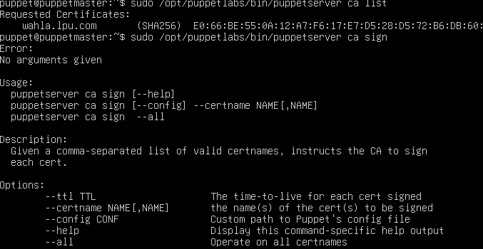
Check CA service is running:
sudo /opt/puppetlabs/bin/puppetserver ca list --all
If facing error as below then follow next steps

Slide 37

2. On Windows Puppet Agent
Install Puppet Agent MSI (from Puppet official site).
Then open PowerShell (Run as Administrator) and configure it:
puppet config set server puppet-master.local --section main
puppet config set certname windows-agent.local --section main
puppet config set environment production --section main
Verify Configuration
Check if values are set correctly:
puppet config print server --section agent
puppet config print certname --section agent
puppet config print environment --section agent

Slide 38
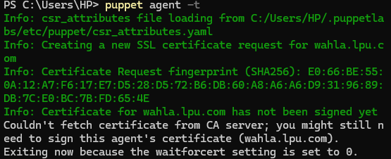
Trigger Certificate Request
puppet agent -t
Facing issue for fetching certificate if you are applying without sign in on master machine, For resolving follow next steps

Slide 39
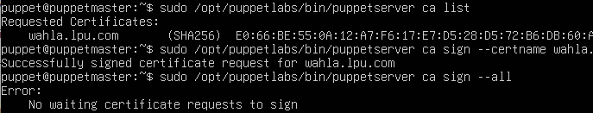
On the Ubuntu Puppet Master check and sign the request:
sudo /opt/puppetlabs/bin/puppetserver ca list
sudo /opt/puppetlabs/bin/puppetserver ca sign --certname wahla.lpu.com
sudo /opt/puppetlabs/bin/puppetserver ca sign --all

Slide 40
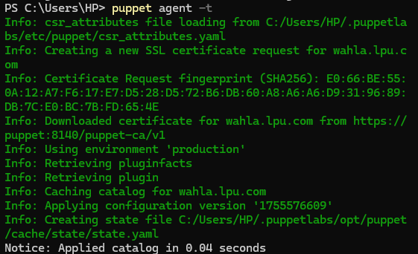
Back on Windows Puppet Agent
After signing, run:
puppet agent –t or
puppet agent --test --waitforcert=60

Slide 41
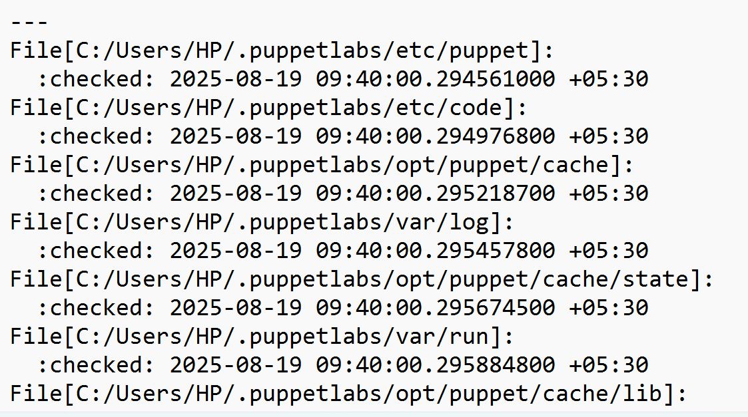
Check yaml.file is available in given path after triggering

Slide 42
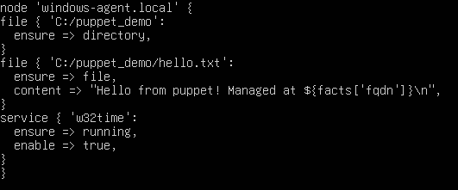
Location of the manifest file
On your Ubuntu Puppet Master:
sudo mkdir -p /etc/puppetlabs/code/environments/production/manifests
sudo nano /etc/puppetlabs/code/environments/production/manifests/site.pp

Slide 43
Validate the manifest on the server
Before applying:
sudo /opt/puppetlabs/bin/puppet parser validate /etc/puppetlabs/code/environments/production/manifests/site.pp
No error=> OK

Slide 44
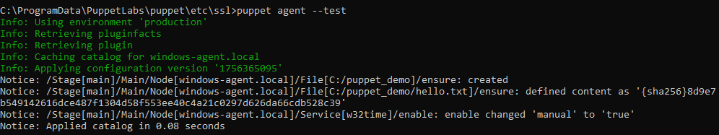
Run the agent to apply manifest
On the Windows machine (elevated PowerShell):
puppet agent –t
or puppet agent --test

Slide 45
Verify File
C:\puppet_demo\hello.txt

